Slide 1

Building Trust in Modern Computing Platforms
Aritra Dhar
ETH Zurich

Slide 2

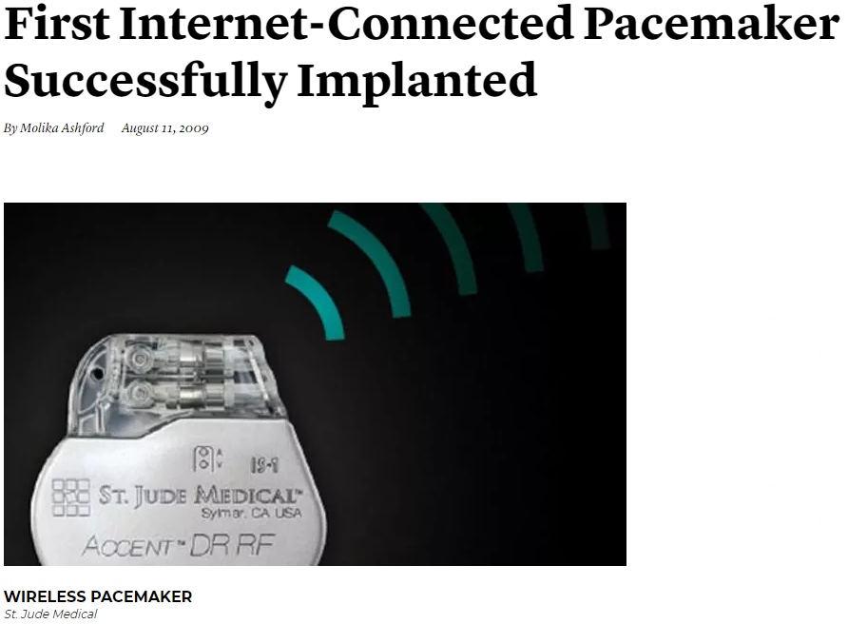


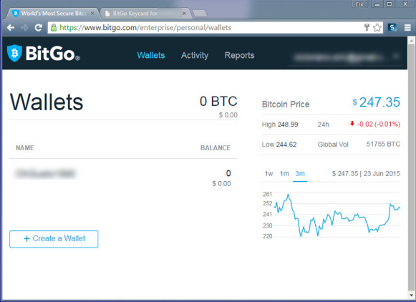

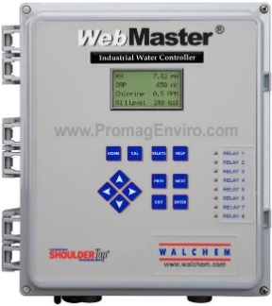
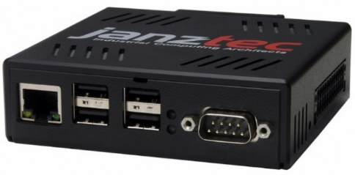
Remote safety/security-critical systems
Images are from janztec, wired, getty, controlbyweb
Notes:
First I will motivate you with some relevant examples that involves remote safety and security critical systems. Automation in industrial sector is getting more prevalent today and more and more of our critical infrastructure such a the electricity grid, gas pipelines, are monitored and actuated by these PLC or programmable logic controller. Compared to traditional PLCS, these are often web-enabled, i.e., they are networked attached and provide a web UI. The operators can remotely connect to the devices, monitor and actuate the equipments.
Other critical systems such as medical implants such as a pacemaker are becoming more and more smart so that a medical technicians can connect to them and monitor vitals or change some operational parameters. Smart homes are also another example where IoT devices report the current state of the home and user can operate them remotely. They also provide web or mobile enabled UI. Other, more traditional use cases could be financial transaction. And more and more people, specially during pandemic are opting for these web services.

Slide 3

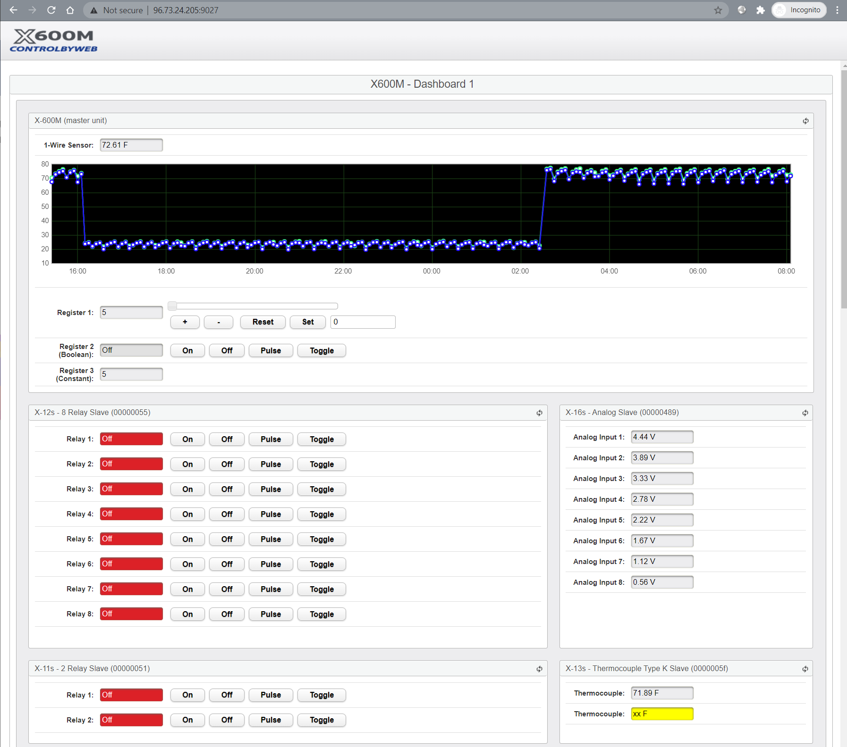
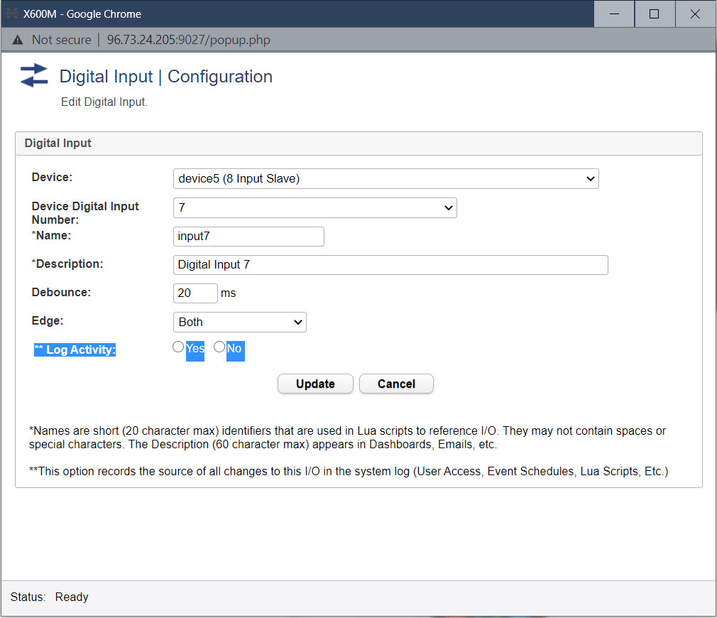
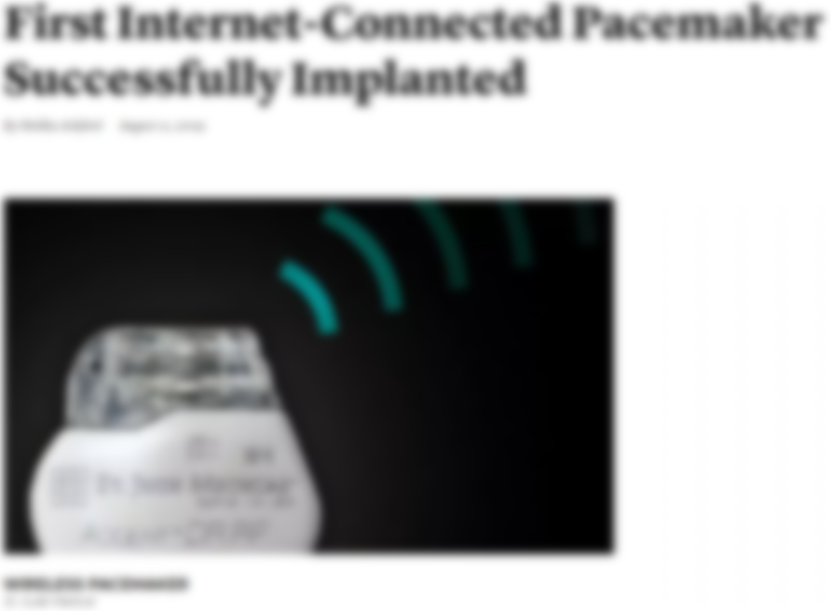



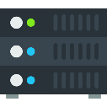




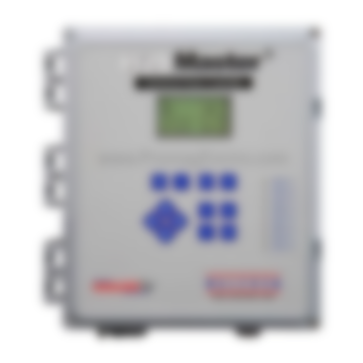



Remote safety/security-critical systems
Images are from janztec, wired, getty, controlbyweb
Notes:
All of these applications have one critical aspect common in them, they all rely on the commodity OS, hypervisors, VMs and browser to interact with the remote systems. And the reliability of these systems are dependent on how the user provide input to them and perceive output.

Slide 4







Large TCB $→$ Large Attack Surface
25.16M
20.92M
2M
36.68M
600K
CPU microcode
Device firmware
Device drivers
Notes:
As the most of the enc users rely on the off the shelf software and hardware such as the browsers and OS/ hypervisors. These are complex software and have millions of lines of code. Which also indicates that they have a large attack surface. And remember that this is just the tip of the iceberg, most of the processor microcode, device drivers and firmware are proprietary. E.g., android is open source but most of the code bases are preoperatory SoC firmware .

Slide 5
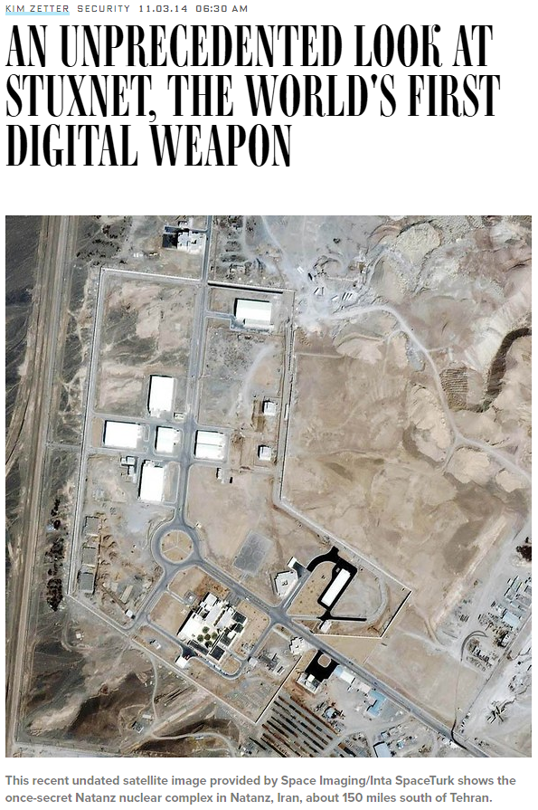
Attacks
Images are from wired, csmonitor, heimdalsecurity
Notes:
Over the time, we have seen a number of attacks that exploits such vulnerability in the OS, device drivers, device firmware such as routers etc.

Slide 6

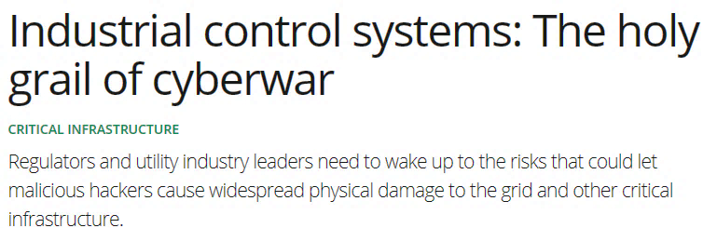
Attacks
Images are from wired, csmonitor, heimdalsecurity
Notes:
Safety critical systems such as the industrial controller are also targets of increased attacks due to their large complexity and usage of commodity hardware and software

Slide 7

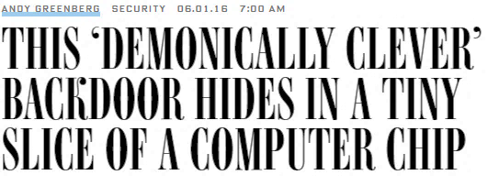
Attacks
Images are from wired, csmonitor, heimdalsecurity
Notes:
Not only the complexity in the software but complexity in the hardware also opens up a large attack surface as a large number of hardware components are squished into a small space and there is no possible way to verify and sophisticated supply chain attach such as an analog malware

Slide 8
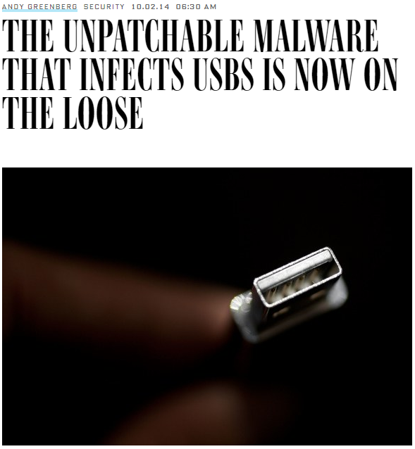

Attacks
Images are from wired, csmonitor, heimdalsecurity
Notes:
BadUSB is also one of the example where a sophisticated supply chain attack can implant malware into the USB and sniff all the sensitive data

Slide 9

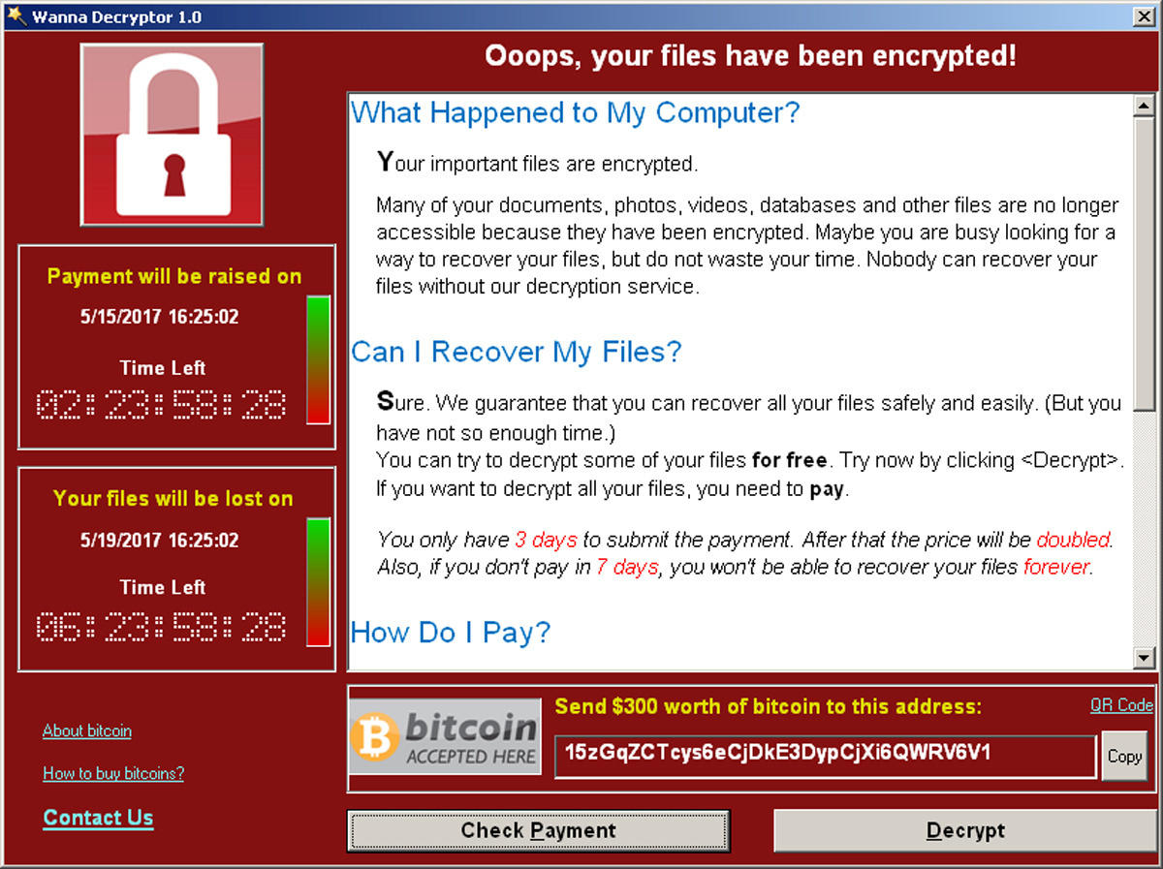
Attacks
Images are from wired, csmonitor, heimdalsecurity
Notes:
And of course, one of the most memorable attacks is the wanncry ransomware attack that exploits an outdated network protocol in Windows XP and cripple entire NHS, the British healthcare systems

Slide 10




Concrete Attack Scenario
Remote device
Heart beat
75
65
Insulin (U)
177
Basal rate (U/Hr)
0.025
Low limit (mg/dL)
60
High limit (mg/dL)
105
Program
Cancel
Aritra Dhar
Notes:
The attacker can not only see the input parameter, but also introduce arbitrary modifications into them, resulting in the misconfiguration in these implants that have serious effect.
Compared to wanncry that was a a malware, the next attack could be more stealthy.

Slide 11






Remote Trusted path
User
IO devices
Host
Remote System
Notes:
Trusted path is an umbrella term that denotes the integrity and confidentiality of the channel between the user IO devices and the target TCB, remote trusted path is an extension where all the communication goes over the untrusted local platform and the network that is also attacker controlled.

Slide 12






Trusted Execution Environment (TEE)
TCB
App
App
App
App
App
Enclave
Operating System
Operating System
Dev
DRAM
CPU
Dev
DRAM
CPU
TCB
TCB
Traditional platforms
Intel SGX
OS still manages devices
Static HW TCB
Notes:
Now TEEs sounds like the perfect way one can solve the problem of large TCB presented by the OS and hypervisors.
Trusted Execution Env or TEE solves some of this problem by reducing the TCB. In traditional platforms, the TCB consists of the application, OS and the hardware. Where in TEE, the application or the enclave is isolated from the OS and other apps by security primitives implemented by the micro processor. In intel SGX, hardware components such as the DRAM and external devices can be attacker-controlled, further reducing the TCB.
However, it is still not straightforward to implement a trusted path in the TEE as the OS still manages all the drivers. Remote attestation is also requires trust in first use which makes the enclaves venerable at the very first attestation. I will revisit this topic later in this talk, and also biggest problem is somewhat static hardware TCB which is sometime hard to define. For example Intel SGX need to trust the Intel ME that manages Nvstorage.

Slide 13

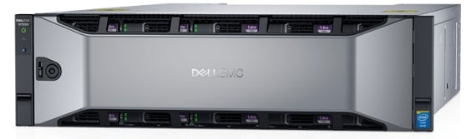
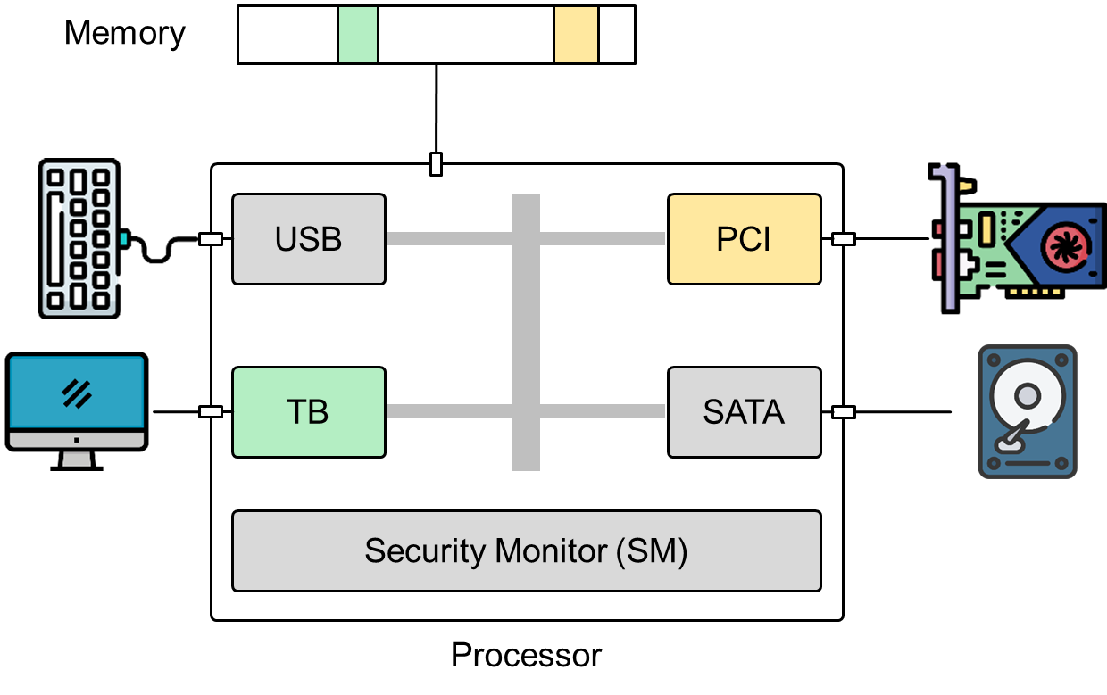
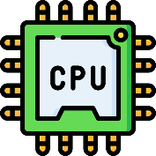
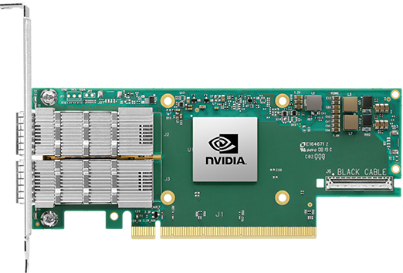
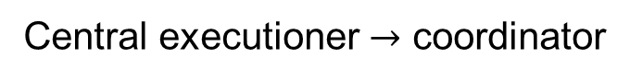
Disaggregated computing
Traditional CPU-centric model
Central executioner $→$ coordinator
Images are from nVidia, Dell, Mellanox official websites
Notes:
However, tg

Slide 14






My Contribution
IntegriKey (2017, eprint: 2017/1245)
ProtectION (NDSS 2020)
IntegriScreen (2018, arXiv:2011.13979)
Remote system
Remote trusted path application

Slide 15
My Contribution
IntegriKey (2017, eprint: 2017/1245)
ProtectION (NDSS 2020)
IntegriScreen (2018, arXiv:2011.13979)
Remote system
Remote trusted path application
ProximiTEE (CODASPY 2020)

Slide 16

My Contribution
IntegriKey (2017, eprint: 2017/1245)
ProtectION (NDSS 2020)
IntegriScreen (2018, arXiv:2011.13979)
Remote system
Remote trusted path application
Dedicated Security Chips in the Age of Secure Enclaves (IEEE S&P magazine 2020)
ProximiTEE (CODASPY 2020)

Slide 17



My Contribution
PIE (2020, arXiv:2010.10416)
IntegriKey (2017, eprint: 2017/1245)
ProtectION (NDSS 2020)
IntegriScreen (2018, arXiv:2011.13979)
Remote system
Remote trusted path application
Dedicated Security Chips in the Age of Secure Enclaves (IEEE S&P magazine 2020)
ProximiTEE (CODASPY 2020)

Slide 18
My Contribution
PIE (2020, arXiv:2010.10416)
IntegriKey (2017, eprint: 2017/1245)
ProtectION (NDSS 2020)
IntegriScreen (2018, arXiv:2011.13979)
Remote system
Remote trusted path application
Dedicated Security Chips in the Age of Secure Enclaves (IEEE S&P magazine 2020)
ProximiTEE (CODASPY 2020)

Slide 19
Today’s Talk
PIE (2020, arXiv:2010.10416)
IntegriKey (2017, eprint: 2017/1245)
ProtectION (NDSS 2020)
IntegriScreen (2018, arXiv:2011.13979)
Remote system
Remote trusted path application
Dedicated Security Chips in the Age of Secure Enclaves (IEEE S&P magazine 2020)
ProximiTEE (CODASPY 2020)
Notes:
However I will also revisit some of the works

Slide 20
ProtectIOn setting
Remote trusted path application
Remote system

Slide 21







Solution 1: Transaction Confirmation Device
Remote device
Heart beat
75
Insulin (U)
177
Basal rate (U/Hr)
0.025
Low limit (mg/dL)
60
Android Protected Confirmation
You are going to program
Heart beat 75
Insulin 177U
Basal rate 0.025 U/Hr
Low level 60 mg/dL
High level 105 mg/dL
And more ……
High limit (mg/dL)
105
Program
Cancel
Notes:
Good for binary decisions, but not for complex large UI

Slide 22



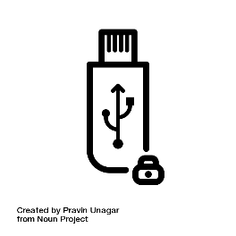
Solution 2: Input Signing
Remote device
Heart beat
75
Insulin (U)
177
Heart beat 75
Insulin 177U
Basal rate 0.025 U/Hr
Low level 60 mg/dL
High level 105 mg/dL
Basal rate (U/Hr)
0.025
Low limit (mg/dL)
60
Trusted embedded device
High limit (mg/dL)
105
Program
Cancel
Notes:
We started to explore this concept with Integrikey …

Slide 23



Display manipulation attack
177
177
Insulin
17
7
1777
Insulin
177
User sees 177
Device records 1777
Host sends 1777
Notes:
Mention that this is not just an implementation issue but more of a fundamental design problem.

Slide 24
Observation 1
The lack of output integrity – the render of user inputs on the screen – compromises input integrity.

Slide 25

Solution 3: Overlay
Remote device
Remote device
Heart beat
Heart beat
75
Insulin (U)
Insulin (U)
177
Basal rate (U/Hr)
Basal rate (U/Hr)
0.025
Low limit (mg/dL)
Low limit (mg/dL)
60
High limit (mg/dL)
High limit (mg/dL)
105
Program
Cancel
Program
Cancel

Slide 26
Overlay: Output Manipulation
Remote device
Remote device
Heart beat
Insulin (U)
Insulin (U)
Heart rate
Basal rate (U/Hr)
Basal rate (U/Hr)
Low limit (mg/dL)
Low limit (mg/cc)
High limit (mg/dL)
High limit (mg/cc)
Program
Cancel
Program
Cancel

Slide 27

Overlay: Output Manipulation
Remote device
Remote device
Heart rate
75
Insulin (U)
177
Insulin (U)
177
Heart rate
75
Basal rate (U/Hr)
0.025
Basal rate (U/Hr)
0.025
Low limit (mg/dL)
60
Low limit (mg/cc)
6000
High limit (mg/dL)
105
High limit (mg/cc)
10500
Program
Cancel
Program
Cancel

Slide 28
Observation 2
If the protected output is provided out-of-context, users are more likely not to verify it.
Therefore input integrity can be violated.

Slide 29
Overlay: Early Form Submission Attack
Remote device
Heart beat
75
Textbox in focus
Insulin (U)
17
Basal rate (U/Hr)
0.025
Fidelius
Trusted overlay from FPGA
Low limit (mg/dL)
60
High limit (mg/dL)
105
OS triggers click
Program
Cancel

Slide 30
Observation 3
If not all the modalities of inputs are secured simultaneously,
none of them can be fully secured.
Notes:
From these observations, we can derive a set of requirements that are fundamental for the security of a remote trausted path

Slide 31






Requirements
The lack of output integrity – the render of user inputs on the screen – compromises input integrity.
Inter-dependency between Input and output

Slide 32
Requirements
If not all the modalities of inputs are secured simultaneously, none of them can be fully secured.
All modalities of input

Slide 33
Requirements
If the protected output is provided out-of-context, users are more likely not to verify it. Therefore input integrity can be violated.
Low cognitive load

Slide 34
Requirements
Low TCB and easy deploy

Slide 35
Requirements

Slide 36








ProtectIOn
Low TCB + fast deployment
Input modalities
IOHub

Slide 37

IO Integrity – Overlay Generation
Remote device
<label for=“insulin” secure=“true”>Insulin (U)</label> <input type="text" id=“insulin" name=“insulin” secure=“true”>
Insulin (U)
Heart rate
Simultaneous IO
Basal rate (U/Hr)
Low limit (mg/cc)
High limit (mg/cc)
Program
Cancel
ProtectIOn JS
<form action=“/some_action”, signature = “0x45AB…”, id = “0x0ab..”>

Slide 38




IO Integrity – Overlay Generation
Simultaneous IO
ProtectIOn JS

Slide 39



IO Integrity – Overlay Generation
Remote device
Verified UI from secure_site.io
Insulin (U)
Heart rate
Simultaneous IO
Basal rate (U/Hr)
Low limit (mg/cc)
High limit (mg/cc)
Program
Cancel

Slide 40


IO Integrity – Input
Remote device
Verified UI from secure_site.io
Insulin (U)
75
Heart rate
177
Simultaneous IO
Basal rate (U/Hr)
0.025
Low limit (mg/cc)
60
High limit (mg/cc)
105
Program
Cancel
ProtectIOn JS

Slide 41
Grabbing User Attention
Output Integrity: Low cognitive load
Several existing mechanisms
Low cognitive load
Put 1 in front of all inputs

Slide 42
Grabbing User Attention
Output Integrity: Low cognitive load
Several existing mechanisms
Lightbox
Low cognitive load
Put 1 in front of all inputs

Slide 43
Grabbing User Attention
Output Integrity: Low cognitive load
Several existing mechanisms
Lightbox
Highlight
Low cognitive load
Put 1 in front of all inputs

Slide 44
Grabbing User Attention
Output Integrity: Low cognitive load
Several existing mechanisms
Lightbox
Highlight
Freezing
Low cognitive load
Put 1 in front of all inputs

Slide 45
Grabbing User Attention
Output Integrity: Low cognitive load
Several existing mechanisms
Lightbox
Highlight
Freezing
Combination
Low cognitive load
Put 1 in front of all inputs

Slide 46
Grabbing User Attention
Output Integrity: Low cognitive load
Several existing mechanisms
Lightbox
Highlight
Freezing
Combination
How to determine when to engage?
Track pointer
Mouse movement on the overlay
Low cognitive load

Slide 47
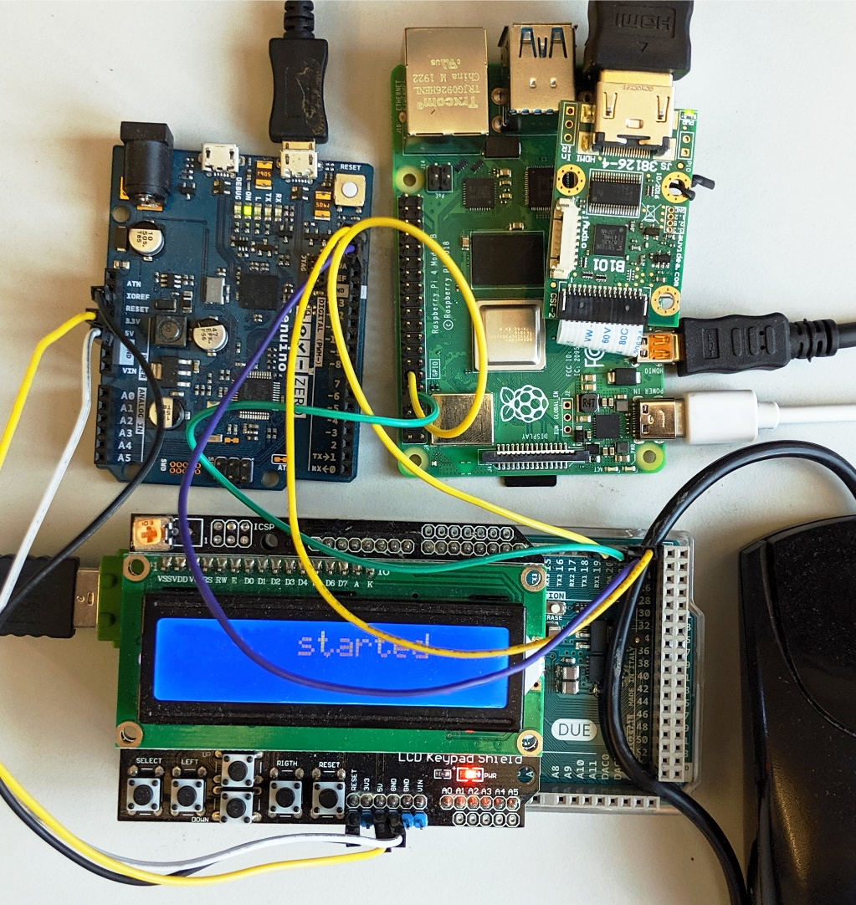

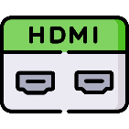







Prototype and TCB
Low TCB
Fast deployment
25.16M
20.92M
1.9K
2M
3.5K
71K
893
600K
121K
36.68M
Notes:
Apart from the low TCB, IOHUB also have limited interfaces that are hard to exploit. HDMI is one way and the USB interfaces only have relay operation, this significantly limits the attacker’s ability to find an exploit.

Slide 48
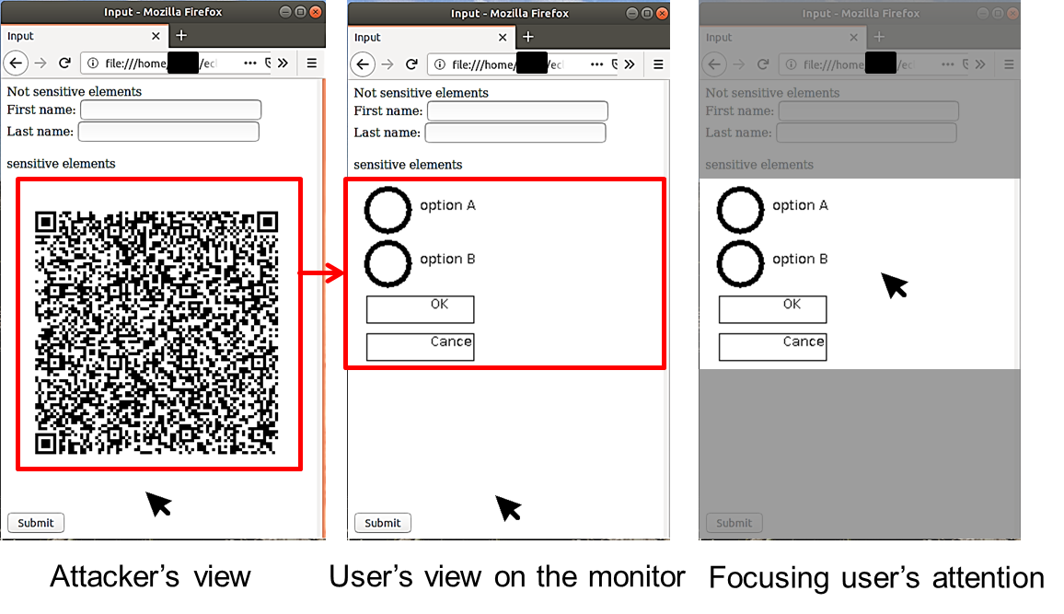

Performance
Display latency: 21.67 ms
~46 fps
Mouse latency: 250 $μs$
Keyboard latency: 170 $μs$
Pointer detection accuracy: 0.997

Slide 49
ProtectIOn $→$ProximiTEE
Remote trusted path application

Slide 50
ProtectIOn $→$ProximiTEE
Remote trusted path application
Identity of the platform

Slide 51







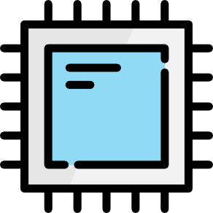

Motivation: Remote Attestation
Sensitive data
Enclave
A legitimate platform
A legitimate enclave
Platform PK
Report
Challenge
CPU
Verifier
Signed report
Notes:
Assume the enclave is accessing your sensitive medical data. As an user you want to know if you are actually executing the actual enclave coming from a reputed software developer or the attacker is impersonating as the legitimate software and may steal your data. To protect against this, TEEs provide remote attestation that enables the user to verify the software….
The processor has an embedded key that is burned into the fuses during the manufacturing process. The key proves that it is a legitimate intel processor.
The attestation report not only contain the code, stack and heap, but also the micro code version number to make sure that attesting platform is using the updated version of the CPU microcode.
After attestation the verifier asserts that 1) she is communicating with a legitimate intel platform and 2) the enclave code is legitimate -- EPID
Problem: a platform, not a specific one

Slide 52





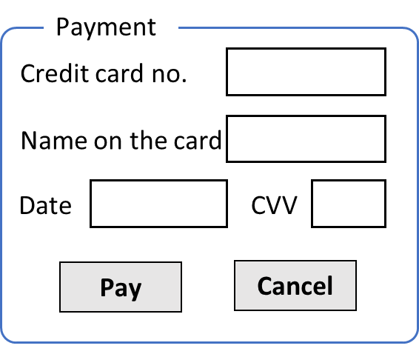

Relay Attacker
Challenge
App
Enclave
OS
Signed report
CPU
Verifier
Target platform
Relay challenge
Signed report
App
Enclave
OS
CPU
Assign secret
Attacker’s platform
Notes:
Relay attacker, Platforms could be geographically separated. Verifier still gets the proper output – a platform and a legitimate enclave. She attest the attacker’s platform rather that the target platform.
** The attack is possible due to the trust on first use property in SGX remote attestation. Note that this problem is not only limited to the SGX but most of the TEEs that provide remote attestation. All the flavors of remote attestation are vulnerable to the relay attack. This include EPID, pseudonymous and other PKI based remote attestation.
** Implication if the relay attack – mention plunder volt.

Slide 53

Our Contribution: Auxiliary Device
App
Enclave
OS
CPU
ProximiKey
Verifier
Target platform
App
Enclave
OS
CPU
Attacker’s platform
Notes:
The main idea here is to distinguish a relay attack from a physical connection. On a high level, we can reduce this problem to a distance bounding problem that is common in wireless communication. Here we can see how we can leverage the distance bounding protocol to TEEs.

Slide 54
ProximiTEE
App
Enclave
Establish secure channel
OS
CPU
ProximiKey
Verifier
Target platform
App
Enclave
OS
CPU
Attacker’s platform

Slide 55
ProximiTEE
App
Enclave
OS
CPU
ProximiKey
Target platform

Slide 56
ProximiTEE
App
Enclave
Initiate remote attestation
OS
Report + platform pk
CPU
ProximiKey
Target platform

Slide 57
ProximiTEE
App
Enclave
Secure channel
OS
CPU
ProximiKey
Target platform

Slide 58
ProximiTEE
Calculate latency
Determine proximity
App
Enclave
Challenge
OS
Response
CPU
ProximiKey
Target platform

Slide 59
ProximiTEE
Verifier
App
Enclave
OS
App
Enclave
CPU
ProximiKey
OS
Target platform
CPU
Attacker’s platform

Slide 60
ProximiTEE
Latency > threshold
Possible relay attack
App
Enclave
OS
CPU
Verifier
Target platform
App
Enclave
OS
CPU
Attacker’s platform

Slide 61



ProximiTEE
App
Enclave
Signed proximity result
OS
CPU
Verifier
Signed report
Target platform
A specific legitimate platform
App
Enclave
A legitimate enclave running on that platform
OS
CPU
Attacker’s platform

Slide 62
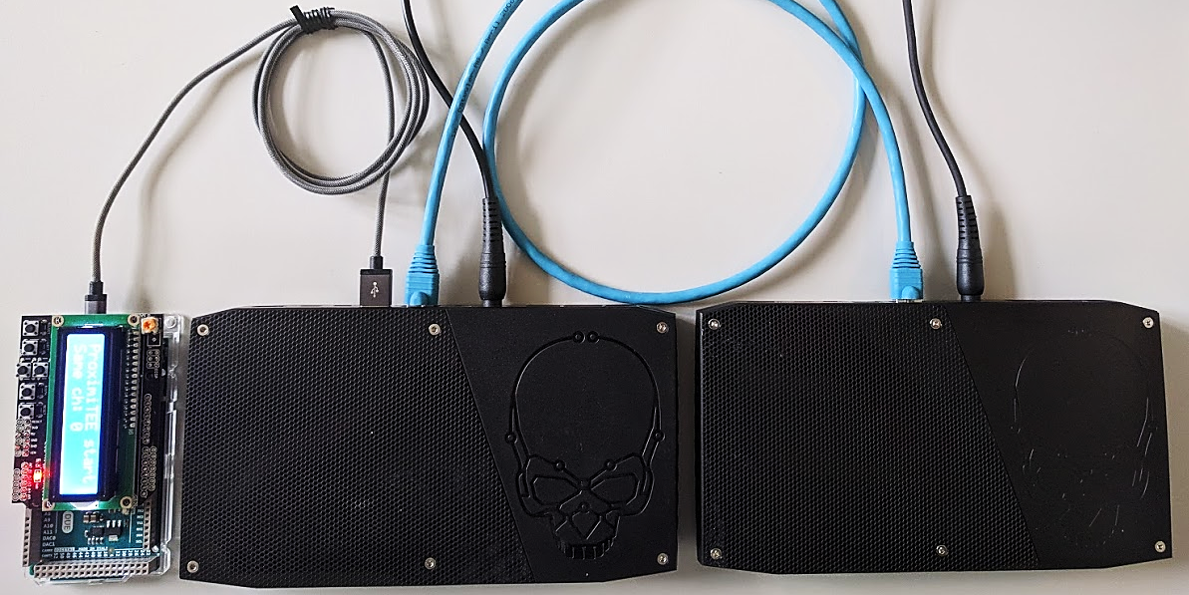
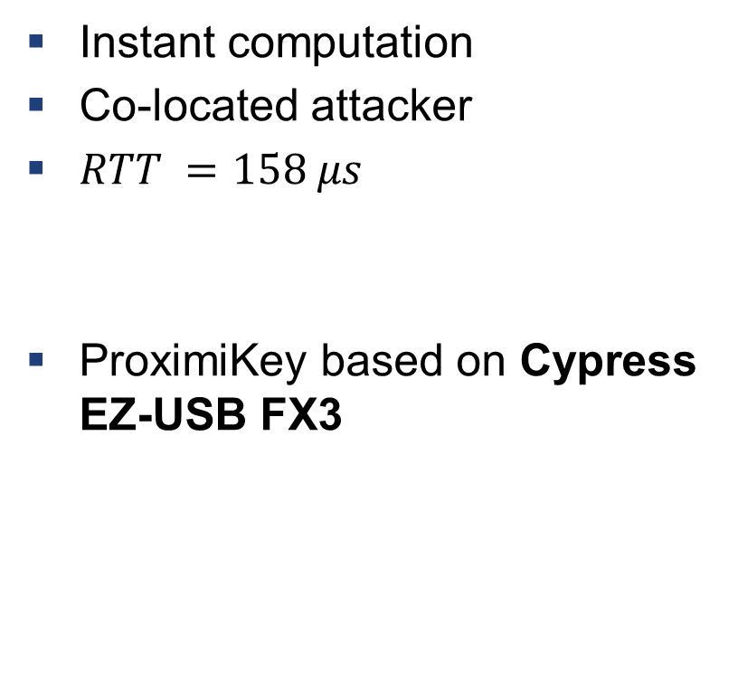
Setup: Simulating a Powerful Attacker
ProximiKey
USB 3.0 interface
1m Ethernet cable
Instant computation
Co-located attacker
$RTT =158 μs$
ProximiKey based on Cypress EZ-USB FX3
Target platform
Attacker’s platform

Slide 63
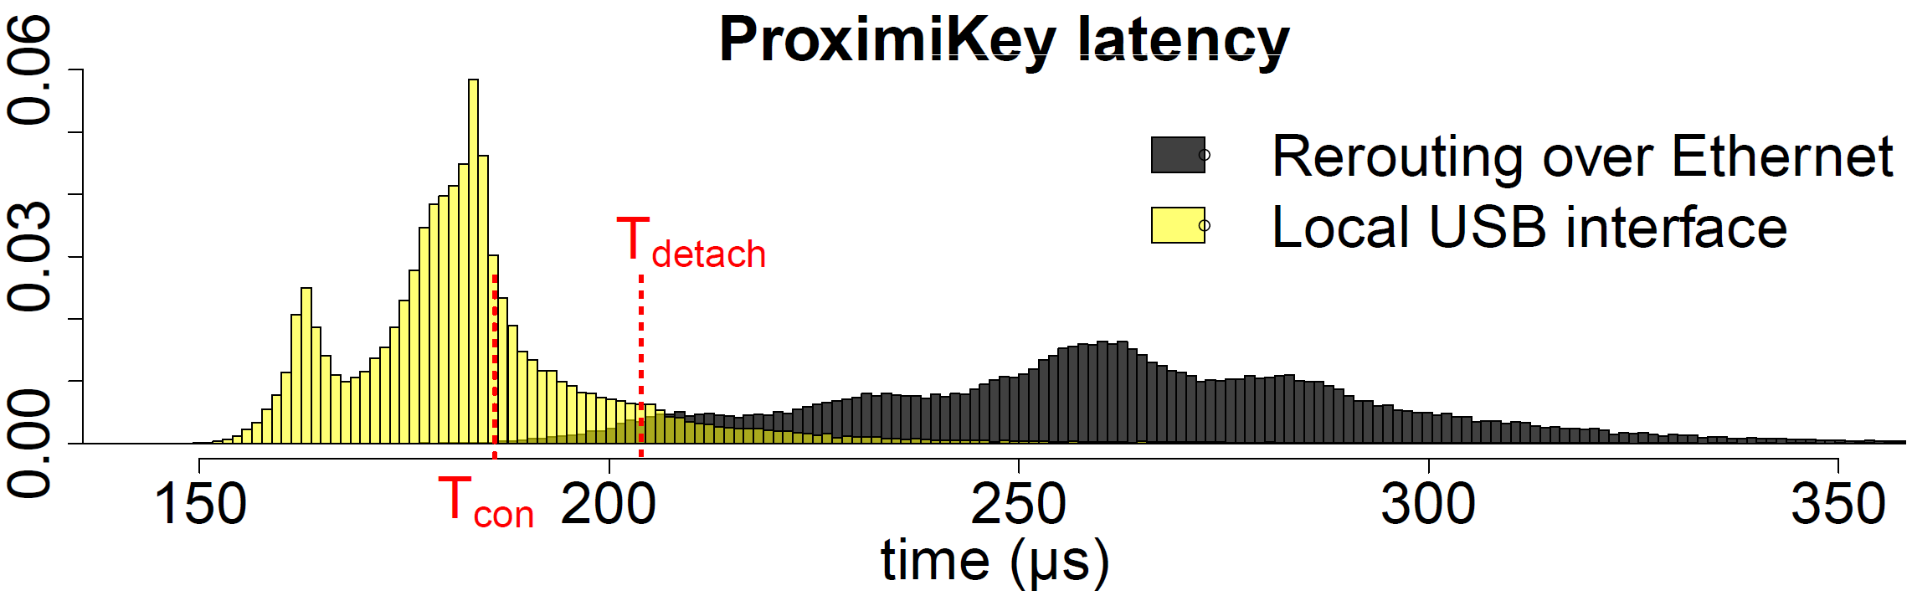
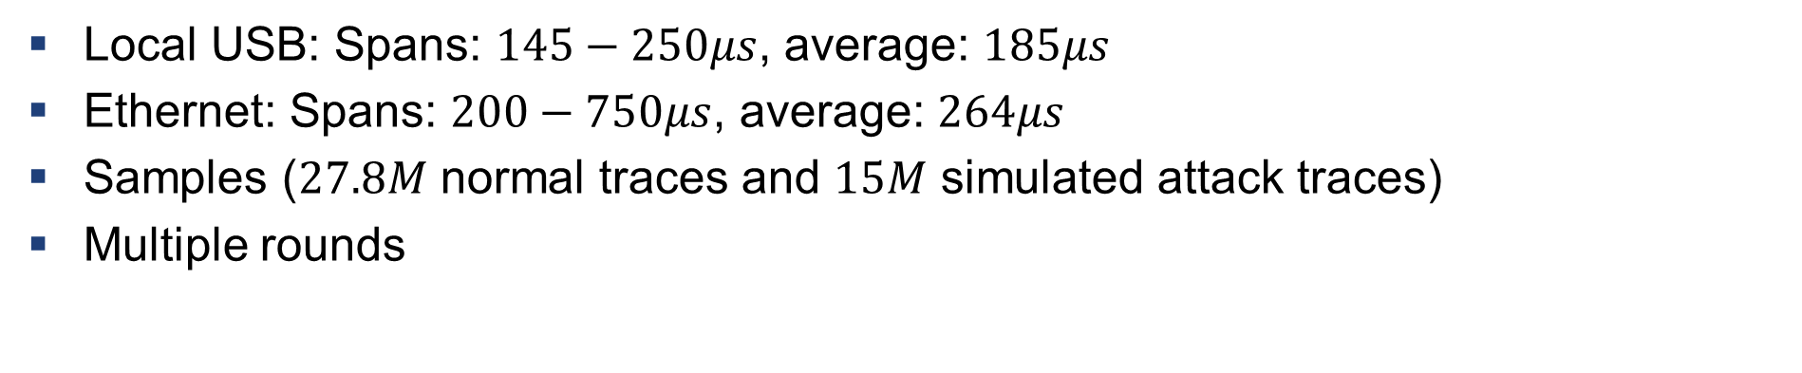
Main Experimental Result
Local USB: Spans: $145−250μs$, average: $185μs$
Ethernet: Spans: $200−750μs$, average: $264μs$
Samples ($27.8M$ normal traces and $15M$ simulated attack traces)
Multiple rounds

Slide 64
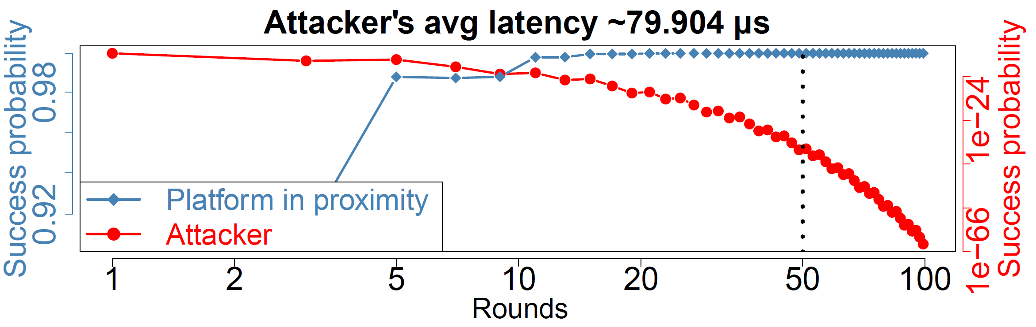
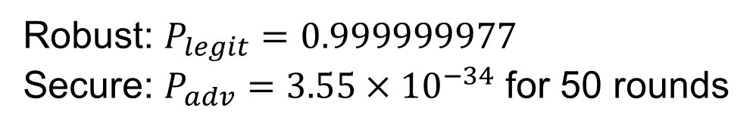
Proximity Verification Result
Robust: $P_{legit}=0.999999977$
Secure: $P_{adv}=3.55×{10}^{−34}$ for 50 rounds
Notes:
Red and blue are two different readings … attacker’s success probabilty goes down

Slide 65



Potential Use case: Trusted IO with Enclaves in Data Centre
I/O
I/O
User
User’s PC
Data center

Slide 66

Potential Use case: Setup of Permissioned Blockchain
Consensus node
Verifiers
Verifiers
Consensus node
Authority
Consensus node

Slide 67
ProtectIOn $→$ProximiTEE $→$ PIE
Remote trusted path application
Identity of the platform

Slide 68
ProtectIOn $→$ProximiTEE $→$ PIE
Remote trusted path application

Slide 69








Challenges
Secure communication
Remote attestation
Runtime attacks
Notes:
In the disaggregation model, we need to address a number of challenges, the first being the secure communication. As the execution is now distributed over multiple hardware components, we need to make sure that the communication between these components and the CPU cores are protected.

Slide 70
Challenges
Secure communication
Remote attestation
Runtime attacks
Notes:
In traditional TEEs, the remote attestation is only limited to the enclaves that re running on the CPU cores. However, if we assume that the execution environments are distributed over multiple hardware component, this needs to be adopted.

Slide 71
Challenges
Secure communication
Remote attestation
Runtime attacks

Slide 72
Challenges
Secure communication
Remote attestation
Runtime attacks
Notes:
Secure communication is a challenge between one need to secure the communication between the CPU core enclaves and the peripheral firmware

Slide 73
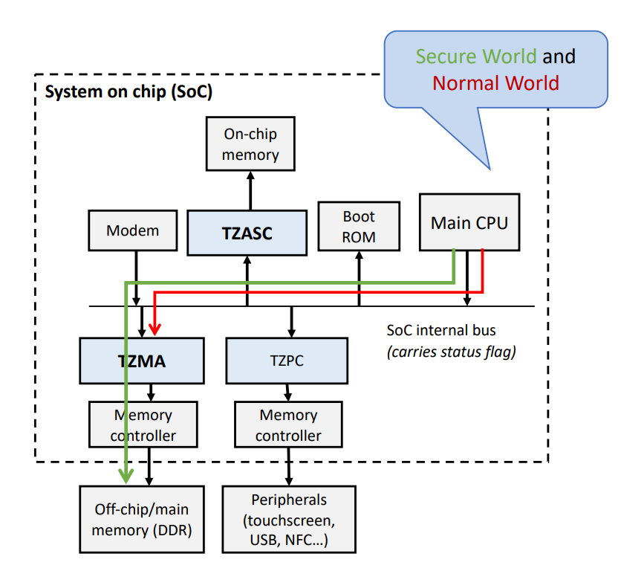
Can Existing TEEs Solve this Problem?
Can Existing TEEs Solve this Problem?
Secure world & non-secure world
App
App
Enclave
App
App
Enclave
U-mode
OS
Peripheral
OS
RT
S-mode
CPU
Peripheral
S-ROT
Security Monitor
M-mode
ARM TrustZone
Intel SGX
RISC-V KeyStone
Sanctuary
VButton
SGXIO
Graviton (SGX + nVidia GPU)
CURE
Notes:
TrustZone mention that there is no isolation between the secure world applications. TrustZone requires to trust entire SoC so no flexible HW TCB
SGX and keystone rely on the OS the relay the communication to the external HW and they also does not provide any flexible TEE + execution happing outside the CPU
Some of the work like Graviton do talk about enclaves on GPU but its very specific only to the GPU and does not extend to general devices, SGXIO need to trust a hypervisor which is a step back

Slide 74
New Challenge
Secure communication
Remote attestation
Runtime attacks
Notes:
In such a disaggregated model,

Slide 75

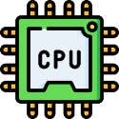





New Challenge
TCB
Secure communication
Remote attestation
Runtime attacks
Least privilege

Slide 76

PIE: Platform Isolation Environment
Platform-wide enclave
Application
Driver
Device
Traditional software model:
PIE software model:
Application enclave
Controller enclave
Device

Slide 77



Communication in Platform Wide enclave
Shared memory
Firmware enclave
Controller enclave
Application enclave
HW-backed isolation
PMP entries:
EPC
EPC
0x00
0x0FF
Shared
Shared
Notes:
Mention that many of the runtime attacks will be mitigated because of the physical memory based isolation

Slide 78
Platform-awareness
Connect
EPC
App
App
Enclave
EPC
Peripheral
OS
EPC
RT
EPC
S-ROT
Security Monitor
Shared
Disconnect
EPC
EPC
Shared
Reset
Destroy internal states

Slide 79

Platform-wide Attestation
Needs
Application enclave report
DMA params
DMA params
Controller enclave 1 report
Controller enclave 2 report
AC policies
AC policies
report
report

Slide 80
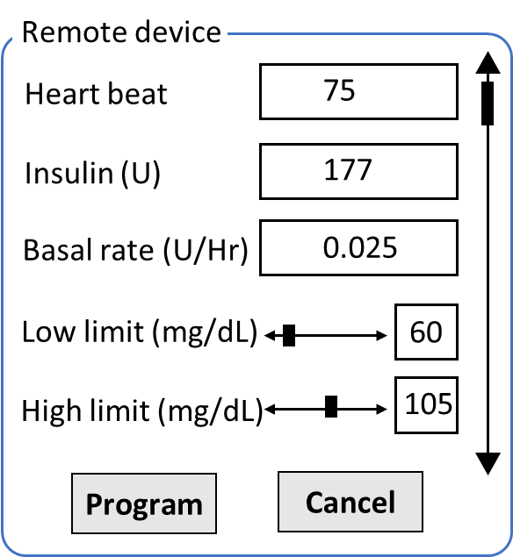




Platform-wide Attestation
Medical App
ML Application
1 MB
2 MB
56 MB
5 GB
KB controller enclave report
Pump controller enclave report
GPU controller enclave report
Exclusive
Exclusive
Shared
report
report
report

Slide 81
Summary of the properties
Platform-wide enclaves
Shared memory communication
Platform awareness
Platform-wide attestation

Slide 82
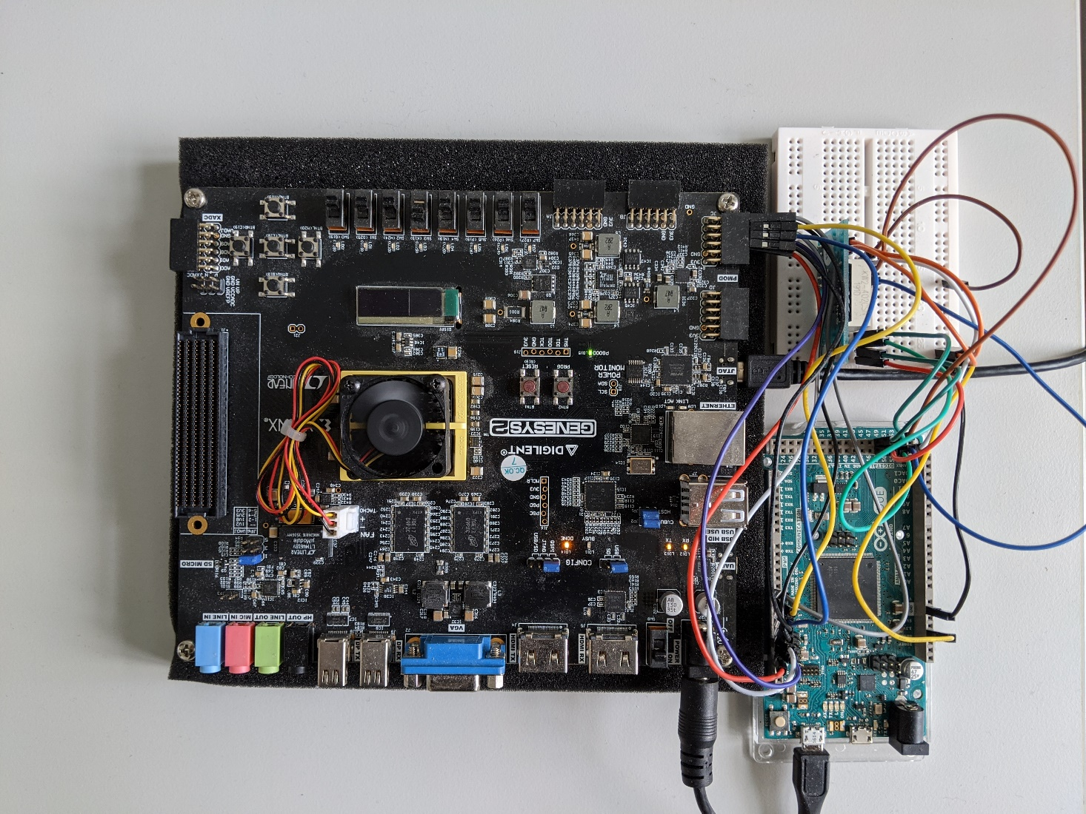
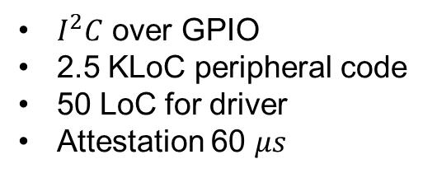
Prototype: simple IO peripherals
Peripheral emulation
FPGA running application class RISC-V core with PMP
PMOD peripheral
$I^{2}C$ over GPIO
2.5 KLoC peripheral code
50 LoC for driver
Attestation 60 $μs$

Slide 83
Prototype: Accelerator
Multi-tenant isolation
4096-core RISC-V* accelerator based on Snitch**
Addition of PMP
Small increase in the core size
750 MHz with 0 PMP
666 MHz with 4 PMP
* Florian Zaruba et. al. 2020. A 4096-core RISC-VChiplet Architecture for Ultra-efficient Floating-point Computing. In2020 IEEEHot Chips 32 Symposium (HCS). IEEE Computer Society, 1–24.
** F. Zaruba et. al. 2020.Snitch: A tinyPseudo Dual-Issue Processor for Area and Energy Efficient Executionof Floating-Point Intensive Workloads.IEEE Trans. Comput.(2020)

Slide 84
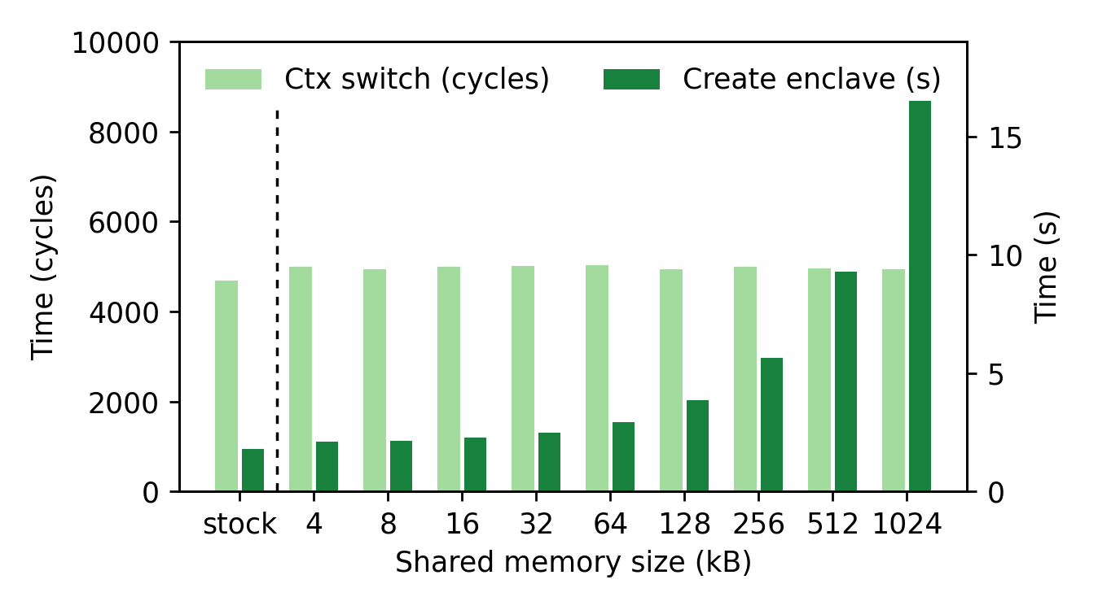
Context switch performance

Slide 85
Summary
PIE
ProtectIOn
Remote system
Remote trusted path application
ProximiTEE
Notes:
However I will also revisit some of the works

Slide 86


Thank you! Questions?

Slide 87
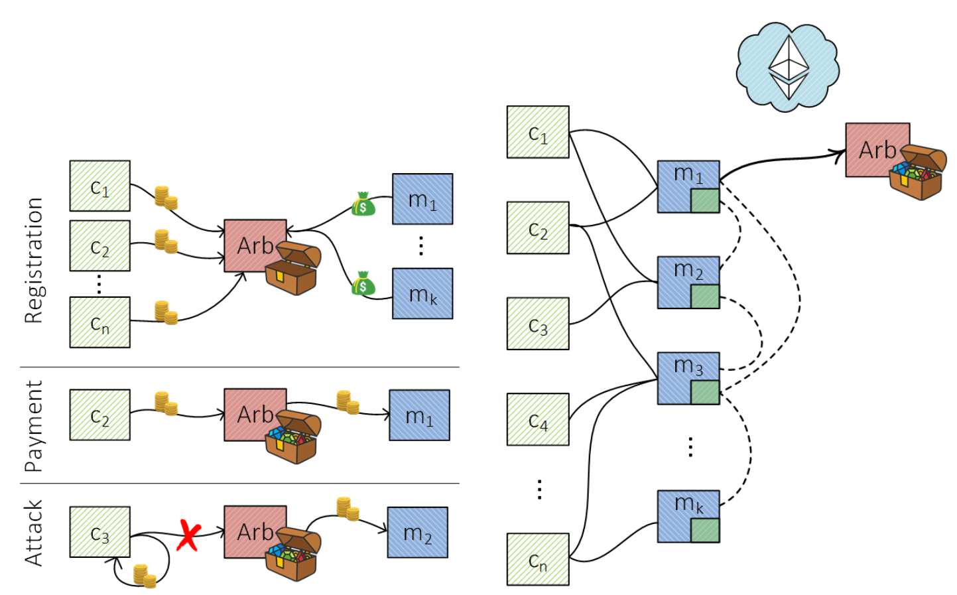
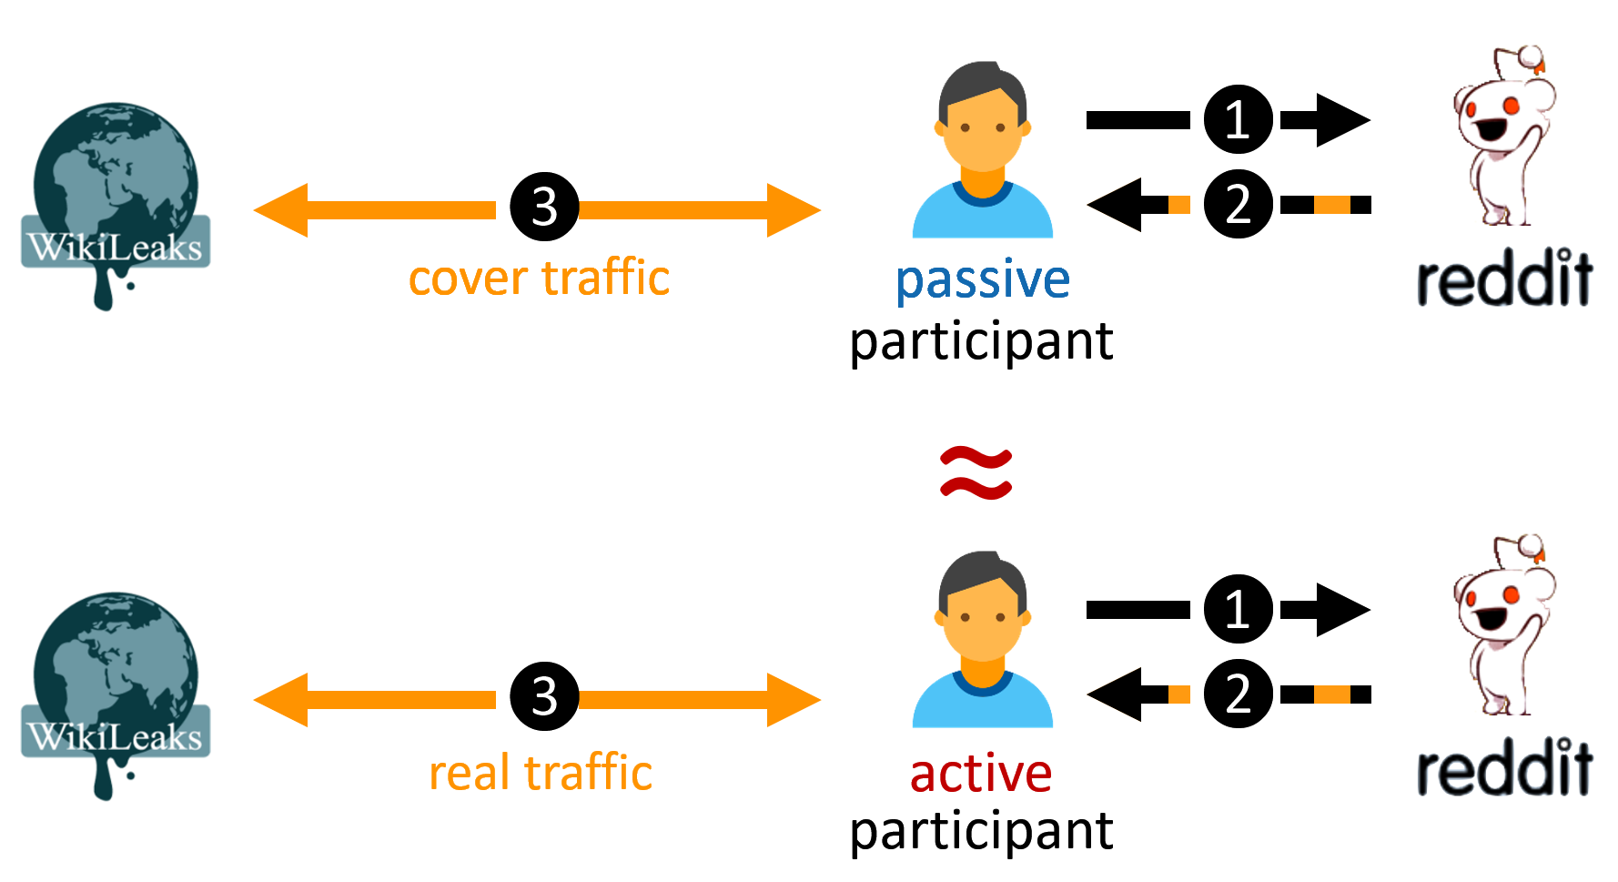
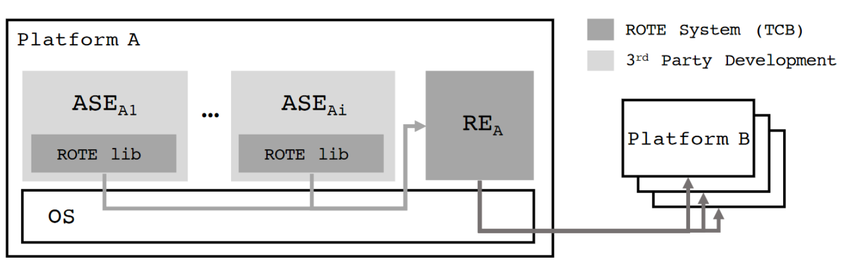
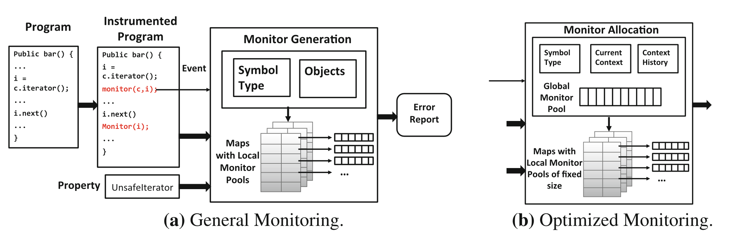
Other contributions
Fast off-chain payments
Snappy (NDSS 2020)
Anonymous communication
CoverUp (NSDI 2019)
Monitoring of type-state properties
Metis (RV 2018)
Rollback protection for SGX
ROTE (USENIX 2017)

Slide 88
Secure Communication
RISC-V PMP: Physical Memory Protection
OS
SM
RT+E
OS
Shared
Pmp0
000
Pmp1
000
Pmp2
111
Pmp2
000

Slide 89
Secure Communication
App
App
Enclave
SM
RT+E
OS
Shared
OS
RT
Pmp0
000
SM
Pmp1
000
Pmp2
111
Pmp2
111

Slide 90
Secure Communication
RISC-V PMP
App
App
Enclave
SM
RT+E
OS
Shared
OS
RT
Pmp0
000
SM
Pmp1
000
Pmp2
111
Pmp2
111

Slide 91
Secure Communication
RISC-V PMP
App
App
Enclave
SM
RT+E
OS
Shared
OS
RT
Pmp0
000
SM
Pmp1
111
Pmp2
000
Pmp2
111

Slide 92
Secure Communication
RISC-V PMP
App
App
Enclave
SM
RT+E
OS
Shared
OS
RT
Pmp0
000
SM
Pmp1
111
Pmp2
000
Pmp2
111

Slide 93
Secure Communication
RISC-V PMP: Physical Memory Protection
App
App
Enclave
SM
RT+E
OS
Shared
OS
RT
Pmp0
000
SM
Pmp1
111
Pmp2
000
Pmp2
111

Slide 94
Secure Communication
RISC-V PMP
Use PMP entries for shared buffers
App
App
Enclave
SM
RT+E
OS
Shared
OS
RT
Pmp0
000
SM
Pmp1
000
Pmp2
111
Pmp2
111

Slide 95


Traditional CPU-centric Model
Memory
USB
PCI
TB
SATA
Security Monitor (SM)
Processor
Notes:
But the biggest problem that TEE have is that they are focus towards traditional computation model where all the computation is executed on the application running on the CPU core. The CPU also manages other peripherals and communicate them over shared memory or memory mapped IO.

Slide 96
Platform-wide Attestation
Connect
Controller enclave 1
Send Cert
Connect
Controller enclave 2
Send Cert

Slide 97
Platform-wide Attestation
Connect
Controller enclave 1
Application enclave
Controller enclave 2
Connect

Slide 98
Platform-wide Attestation
Connect
Controller enclave 1
Application enclave
Controller enclave 2
Connect

Slide 99
Platform-wide Attestation
Controller enclave 1
Challenge
Application enclave
Controller enclave 2

Slide 100
Platform-wide Attestation
App enclave report
Controller enclave 1
Application enclave
Controller enclave 2
Controller enclave 1 ID
Controller enclave 2 ID

Slide 101
Platform-wide Attestation
App enclave report
Controller enclave 1
Application enclave
Controller enclave 2
Controller enclave 1 ID
Controller enclave 2 ID

Slide 102
Platform-wide Attestation
Challenge
Controller enclave 1
Application enclave
Controller enclave 2
Challenge

Slide 103
Platform-wide Attestation
Controller enclave 1 report + report
Controller enclave 1
Application enclave
Controller enclave 2
Controller enclave 2 report + report

Slide 104



Platform-wide Attestation
Firmware
Controller enclave
Application enclave
Remote verifier
Connect
Deploy
Establish shared memory
Challenge
Firmware report
Connect
Establish shared memory
Includes connection parameters
AE report +
CE list
Remote attestation
CE + firmware report
Secret
provision
Shared memory comm
Shared memory comm

Slide 105
Summary
ProtectIOn
Observation of existing trusted path systems
Fundamental security properties
A system that encapsulates all these properties
ProximiTEE
Porting trusted path solution in TEEs is non-trivial
Trust on First use in remote attestation: rerouting attack
Distance bounding to identify a platform
PIE
Disaggregate compute model
Platform-wide enclaves: extend enclaves from CPU cores to other HW
Platform awareness and platform-wide attestation

